Slide 1
Abstraction in Java
Abstraction is a process of hiding the implementation details and showing only functionality to the user.
Another way, it shows only essential things to the user and hides the internal details, for example, sending SMS where you type the text and send the message. You don't know the internal processing about the message delivery.
Abstraction lets you focus on what the object does instead of how it does it.
Ways to achieve Abstraction
There are two ways to achieve abstraction in java
Abstract class (0 to 100%)
Interface (100%)

Slide 2
Abstract class in Java
A class which is declared as abstract is known as an abstract class.
It can have abstract and non-abstract methods.
It needs to be extended and its method implemented.
It cannot be instantiated
abstract class Bike{
abstract void run();
}
class Honda4 extends Bike{
void run(){
System.out.println("running safely");
}
public static void main(String args[]){
Bike obj = new Honda4();
obj.run();
}
}

Slide 3
//Example of an abstract class that has abstract and non-abstract methods
abstract class Bike{
Bike(){
System.out.println("bike is created");
}
abstract void run();
void changeGear(){
System.out.println("gear changed");}
}
//Creating a Child class which inherits Abstract class
class Honda extends Bike{
void run(){
System.out.println("running safely..");}
}
//Creating a Test class which calls abstract and non-abstract methods
class TestAbstraction2{
public static void main(String args[]){
Bike obj = new Honda();
obj.run();
obj.changeGear();
}
}
bike is created
running safely..
gear changed

Slide 4
Interface in Java
An interface in Java is a blueprint of a class. It has static constants and abstract methods.
The interface in Java is a mechanism to achieve abstraction. There can be only abstract methods in the Java interface, not method body. It is used to achieve abstraction and multiple inheritance in Java.
In other words, you can say that interfaces can have abstract methods and variables. It cannot have a method body.
Since Java 8, we can have default and static methods in an interface.
Since Java 9, we can have private methods in an interface.

Slide 5
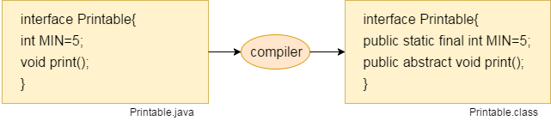
The Java compiler adds public and abstract keywords before the interface method. Moreover, it adds public, static and final keywords before data members.
In other words, Interface fields are public, static and final by default, and the methods are public and abstract

Slide 6
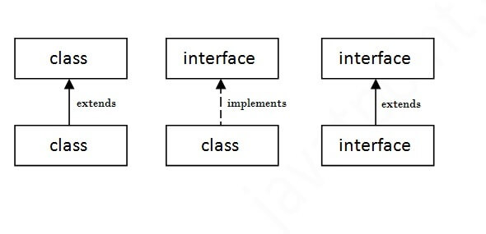
interface printable{
void print();
}
class A6 implements printable{
public void print(){
System.out.println("Hello");}
public static void main(String args[]){
A6 obj = new A6();
obj.print();
}
}

Slide 7
interface Bank{
float rateOfInterest();
}
class SBI implements Bank{
public float rateOfInterest(){
return 9.15f;
}
}
class PNB implements Bank{
public float rateOfInterest(){
return 9.7f;
}
}
class TestInterface2{
public static void main(String[] args){
Bank b=new SBI();
System.out.println("ROI: "+b.rateOfInterest());
}
}

Slide 8
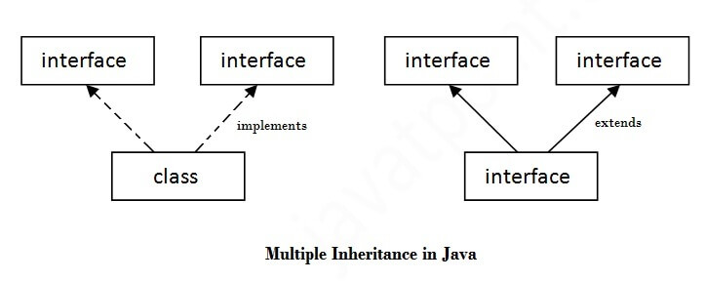
Multiple inheritance in Java by interface
If a class implements multiple interfaces, or an interface extends multiple interfaces, it is known as multiple inheritance.

Slide 9
interface Printable{
void print();
}
interface Showable{
void show();
}
class A7 implements Printable,Showable{
public void print(){
System.out.println("Hello");
}
public void show(){
System.out.println("Welcome");
}
public static void main(String args[]){
A7 obj = new A7();
obj.print();
obj.show();
}
}

Slide 10
Interface inheritance
A class implements an interface, but one interface extends another interface.
interface Printable{
void print();
}
interface Showable extends Printable{
void show();
}
class TestInterface4 implements Showable{
public void print(){
System.out.println("Hello");
}
public void show(){
System.out.println("Welcome");
}
public static void main(String args[]){
TestInterface4 obj = new TestInterface4();
obj.print();
obj.show();
}
}

Slide 11
Abstract class | Interface
1) Abstract class can have abstract and non-abstract methods. | Interface can have only abstract methods. Since Java 8, it can have default and static methods also.
2) Abstract class doesn't support multiple inheritance. | Interface supports multiple inheritance.
3) Abstract class can have final, non-final, static and non-static variables. | Interface has only static and final variables.
4) Abstract class can provide the implementation of interface. | Interface can't provide the implementation of abstract class.
5) The abstract keyword is used to declare abstract class. | The interface keyword is used to declare interface.
6) An abstract class can extend another Java class and implement multiple Java interfaces. | An interface can extend another Java interface only.
7) An abstract class can be extended using keyword "extends". | An interface can be implemented using keyword "implements".
8) A Java abstract class can have class members like private, protected, etc. | Members of a Java interface are public by default.
Example public abstract class Shape{ public abstract void draw(); } | Example: public interface Drawable{ void draw(); }

Slide 12
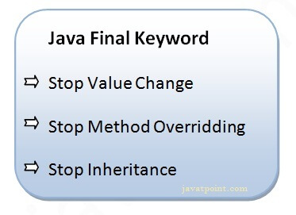
Final Keyword In Java
The final keyword in java is used to restrict the user. The java final keyword can be used in many context.
Final can be:
variable
method
class

Slide 13
1) Java final variable
If you make any variable as final, you cannot change the value of final variable(It will be constant).
class Bike9{
final int speedlimit=90;//final variable
void run(){
speedlimit=400;
}
public static void main(String args[]){
Bike9 obj=new Bike9();
obj.run();
}
}//end of class
Output:Compile Time Error

Slide 14
2) Java final method
If you make any method as final, you cannot override it.
class Bike{
final void run(){
System.out.println("running");
}
}
class Honda extends Bike{
void run(){
System.out.println("running safely with 100kmph");
}
public static void main(String args[]){
Honda honda= new Honda();
honda.run();
}
}
error: run() in Honda cannot override run() in Bike safely with 100kmph");} ^ overridden method is final 1 error
final method is inherited but you cannot override it.

Slide 15
3) Java final class
If you make any class as final, you cannot extend it.
final class Bike{
}
class Honda1 extends Bike{
void run(){
System.out.println("running safely with 100kmph");}
public static void main(String args[]){
Honda1 honda= new Honda1();
honda.run();
}
}
Output:Compile Time Error

Slide 16
Can we initialize blank final variable?
Yes, but only in constructor. For example:
lass Bike10{
final int speedlimit;//blank final variable
Bike10(){
speedlimit=70;
System.out.println(speedlimit);
}
public static void main(String args[]){
new Bike10();
}
}

Slide 17
static blank final variable
A static final variable that is not initialized at the time of declaration is known as static blank final variable.
It can be initialized only in static block.
class A{
static final int data;//static blank final variable
static{
data=50;
}
public static void main(String args[]){
System.out.println(A.data);
}
}

Slide 18
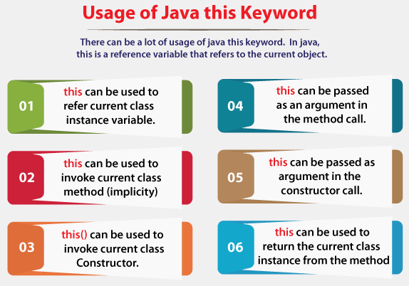

Slide 19
1) this: to refer current class instance variable
class Student{
int rollno;
String name;
float fee;
Student(int rollno,String name,float fee){
this.rollno=rollno;
this.name=name;
this.fee=fee;
}
void display(){System.out.println(rollno+" "+name+" "+fee);}
}
class TestThis2{
public static void main(String args[]){
Student s1=new Student(111,"ankit",5000f);
Student s2=new Student(112,"sumit",6000f);
s1.display();
s2.display();
}
}
If local variables(formal arguments) and instance variables are different, there is no need to use this keyword

Slide 20
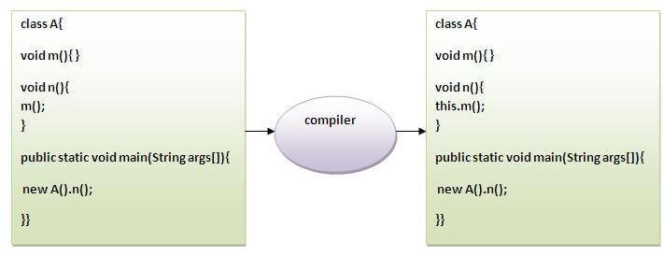
2) this: to invoke current class method
you may invoke the method of the current class by using the this keyword.
If you don't use the this keyword, compiler automatically adds this keyword while invoking the method.
class A{
void m(){
System.out.println("hello m");}
void n(){
System.out.println("hello n");
//m();//same as this.m()
this.m();
}
}
class TestThis4{
public static void main(String args[]){
A a=new A();
a.n();
}
}

Slide 21
3) this() : to invoke current class constructor
The this() constructor call can be used to invoke the current class constructor. It is used to reuse the constructor.
In other words, it is used for constructor chaining.
class A{
A(){
System.out.println("hello a");}
A(int x){
this();
System.out.println(x);
}
}
class TestThis5{
public static void main(String args[]){
A a=new A(10);
}
}
Calling default constructor from parameterized constructor:
hello a
10

Slide 22
Calling parameterized constructor from default constructor:
class A{
A(){
this(5);
System.out.println("hello a");
}
A(int x){
System.out.println(x);
}
}
class TestThis6{
public static void main(String args[]){
A a=new A();
}
}
Rule: Call to this() must be the first statement in constructor.
5
hello a

Slide 23
4) this: to pass as an argument in the method
this keyword can also be passed as an argument in the method. It is mainly used in the event handling.
class S2{
void m(S2 obj){
System.out.println("method is invoked");
}
void p(){
m(this);
}
public static void main(String args[]){
S2 s1 = new S2();
s1.p();
}
}
In event handling (or) in a situation where we have to provide reference of a class to another one.
It is used to reuse one object in many methods.

Slide 24
5) this: to pass as argument in the constructor call
We can pass this keyword in the constructor also. It is useful if we have to use one object in multiple classes.
class B{
A4 obj;
B(A4 obj){
this.obj=obj;
}
void display(){
System.out.println(obj.data);//using data member of A4 class
}
}
class A4{
int data=10;
A4(){
B b=new B(this);
b.display();
}
public static void main(String args[]){
A4 a=new A4();
}
}

Slide 25
6) this keyword can be used to return current class instance
We can return this keyword as an statement from the method.
In such case, return type of the method must be the class type (non-primitive).
return_type method_name(){
return this;
}
class A{
A getA(){
return this;
}
void msg(){
System.out.println("Hello java");
}
}
class Test1{
public static void main(String args[]){
new A().getA().msg();
}
}

Slide 26
Polymorphism in Java
Polymorphism in Java is a concept by which we can perform a single action in different ways.
There are two types of polymorphism in Java: compile-time polymorphism and runtime polymorphism.
We can perform polymorphism in java by method overloading and method overriding.
If you overload/hiding a static method in Java, it is the example of compile time polymorphism.
Runtime Polymorphism in Java
Runtime polymorphism or Dynamic Method Dispatch is a process in which a call to an overridden method is resolved at runtime rather than compile-time.
In this process, an overridden method is called through the reference variable of a superclass.
The determination of the method to be called is based on the object being referred to by the reference variable.

Slide 27
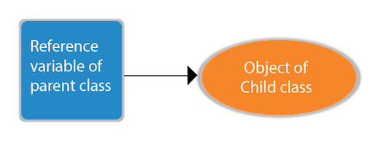
Upcasting
If the reference variable of Parent class refers to the object of Child class, it is known as upcasting.
class A {
}
class B extends A {
}
interface I {
}
class A {
}
class B extends A implements I {
}

Slide 28
class Bike{
void run(){
System.out.println("running");
}
}
class Splendor extends Bike{
void run(){
System.out.println("running safely with 60km");
}
public static void main(String args[]){
Bike b = new Splendor();//upcasting
b.run();
}
}
OUTPUT:
running safely with 60km.
Since method invocation is determined by the JVM not compiler, it is known as runtime polymorphism.

Slide 29
A method is overridden, not the data members, so runtime polymorphism can't be achieved by data members.
it will access the data member of the Parent class always.
class Bike{
int speedlimit=90;
}
class Honda3 extends Bike{
int speedlimit=150;
public static void main(String args[]){
Bike obj=new Honda3();
System.out.println(obj.speedlimit);//90
}

Slide 30
class Animal{
void eat(){
System.out.println("eating");}
}
class Dog extends Animal{
void eat(){
System.out.println("eating fruits");}
}
class BabyDog extends Dog{
void eat(){
System.out.println("drinking milk");}
public static void main(String args[]){
Animal a1,a2,a3;
a1=new Animal();
a2=new Dog();
a3=new BabyDog();
a1.eat();
a2.eat();
a3.eat();
}
}
eating
eating fruits
drinking Milk

Slide 31
The java instanceof operator is used to test whether the object is an instance of the specified type (class or subclass or interface).
The instanceof in java is also known as type comparison operator because it compares the instance with type.
It returns either true or false.
If we apply the instanceof operator with any variable that has null value, it returns false.
class Simple1{
public static void main(String args[]){
Simple1 s=new Simple1();
System.out.println(s instanceof Simple1);//true
}
}
class Dog2{
public static void main(String args[]){
Dog2 d=null;
System.out.println(d instanceof Dog2);//false
}

Slide 32
Downcasting with java instanceof operator
When Subclass type refers to the object of Parent class, it is known as downcasting.
If we perform it directly, compiler gives Compilation error.
If you perform it by typecasting, ClassCastException is thrown at runtime.
Dog d=new Animal();//Compilation error
Dog d=(Dog)new Animal();
//Compiles successfully but ClassCastException is thrown at runtime

Slide 33
class Animal { }
class Dog3 extends Animal {
static void method(Animal a) {
if(a instanceof Dog3){
Dog3 d=(Dog3)a;//downcasting
System.out.println("ok downcasting performed");
}
}
public static void main (String [] args) {
Animal a=new Dog3();
Dog3.method(a);
}
}

Slide 34
Downcasting can also be performed without the use of instanceof operator
class Animal { }
class Dog4 extends Animal {
static void method(Animal a) {
Dog4 d=(Dog4)a;//downcasting
System.out.println("ok downcasting performed");
}
public static void main (String [] args) {
Animal a=new Dog4();
Dog4.method(a);
}
}

Slide 35
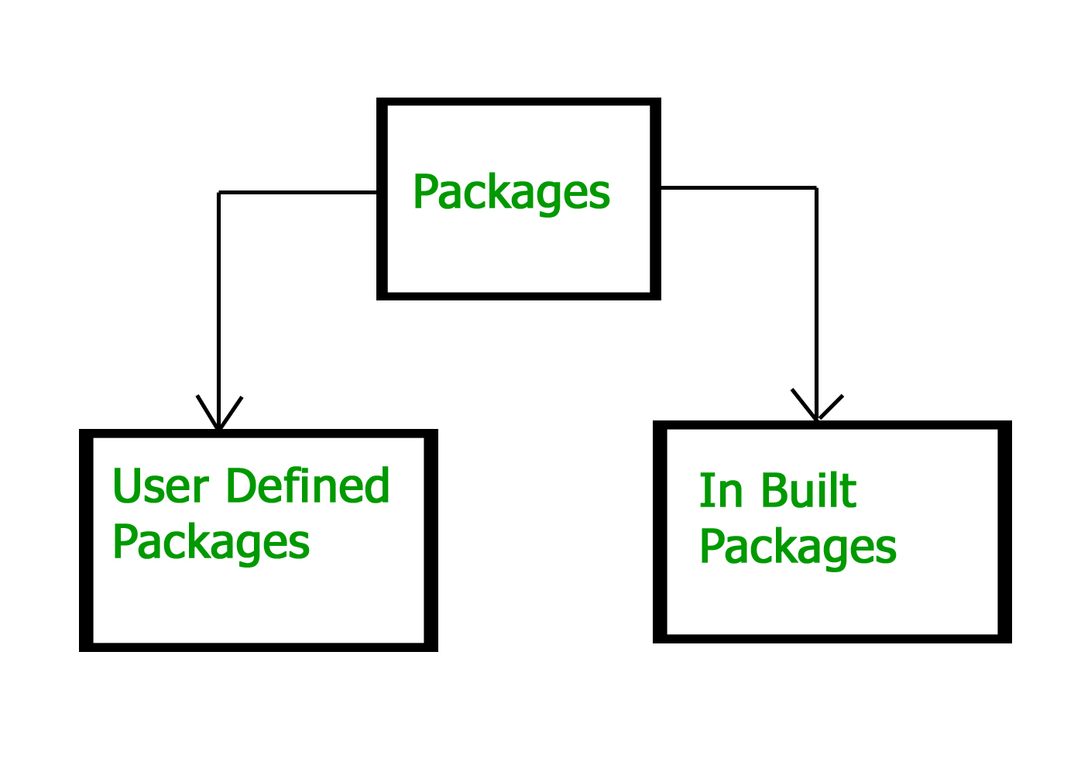
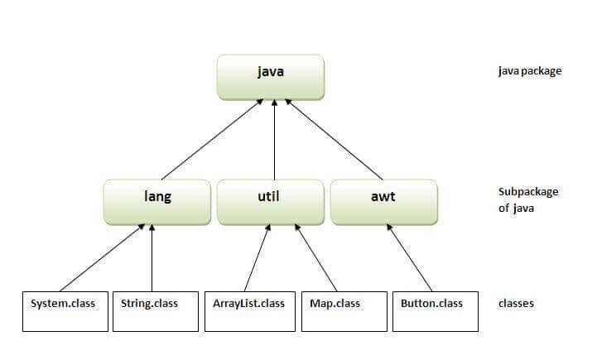
Java Package
A java package is a group of similar types of classes, interfaces and sub-packages. i.e., Package in Java is a mechanism to encapsulate a group of classes, sub packages and interfaces.
Package in java can be categorized in two form, built-in package and user-defined package.
There are many built-in packages such as java, lang, awt, javax, swing, net, io, util, sql etc.
Advantage of Java Package
1) Java package is used to categorize the classes and interfaces so that they can be easily maintained.
2) Java package provides access protection.
3) Java package removes naming collision.

Slide 36
Built-in Packages
These packages consist of a large number of classes which are a part of Java API.
Some of the commonly used built-in packages are:
1) java.lang: Contains language support classes(e.g classed which defines primitive data types, math operations). This package is automatically imported.
2) java.io: Contains classed for supporting input / output operations.
3) java.util: Contains utility classes which implement data structures like Linked List, Dictionary and support ; for Date / Time operations.
4) java.applet: Contains classes for creating Applets.
5) java.awt: Contain classes for implementing the components for graphical user interfaces (like button , ;menus etc).
6) java.net: Contain classes for supporting networking operations.

Slide 37
User-defined packages
These are the packages that are defined by the user.
First we create a directory myPackage (name should be same as the name of the package).
Then create the MyClass inside the directory with the first statement being the package names.
/* import 'MyClass' class from 'names' myPackage */
import myPackage.MyClass;
public class PrintName {
public static void main(String args[]) {
// Initializing the String variable with a value
String name = "GKS;
// Creating an instance of class MyClass in the package.
MyClass obj = new MyClass();
obj.getNames(name);
}
}
package myPackage;
public class MyClass {
public void getNames(String s) {
System.out.println(s);
}
}

Slide 38
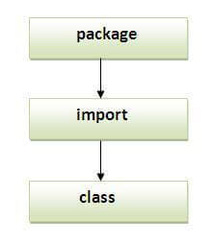
Note: Sequence of the program must be package then import then class.

Slide 39
Package names and directory structure are closely related.
For example if a package name is college.staff.cse, then there are three directories, college, staff and cse such that cse is present in staff and staff is present college.
Also, the directory college is accessible through CLASSPATH variable, i.e., path of parent directory of college is present in CLASSPATH.
The idea is to make sure that classes are easy to locate.

Slide 40
package mypack;
public class Simple{
public static void main(String args[]){
System.out.println("Welcome to package");
}
}
How to access package from another package?
There are three ways to access the package from outside the package.
import package.*;
import package.classname;
fully qualified name.

Slide 41
1) Using packagename.*
If you use package.* then all the classes and interfaces of this package will be accessible but not subpackages.
//save by B.java
package mypack;
import pack.*;
class B{
public static void main(String args[]){
A obj = new A();
obj.msg();
}
}
//save by A.java
package pack;
public class A{
public void msg(){
System.out.println("Hello");}
}

Slide 42
2) Using packagename.classname
If you import package.classname then only declared class of this package will be accessible.
//save by B.java
package mypack;
import pack.A;
class B{
public static void main(String args[]){
A obj = new A();
obj.msg();
}
}

Slide 43
3) Using fully qualified name
If you use fully qualified name then only declared class of this package will be accessible.
Now there is no need to import.
But you need to use fully qualified name every time when you are accessing the class or interface.
//save by A.java
package pack;
public class A{
public void msg(){
System.out.println("Hello");}
}
//save by B.java
package mypack;
class B{
public static void main(String args[]){
pack.A obj = new pack.A();//using fully qualified name
obj.msg();
}
}

Slide 44
What are the differences between import and static import statements in Java?
We can use an import statement to import classes and interface of a particular package.
Whenever we are using import statement it is not required to use the fully qualified name and we can use short name directly.
We can use static import to import static member from a particular class and package.
Whenever we are using static import it is not required to use the class name to access static member and we can use directly.

Slide 45
import statement
To access a class or method from another package we need to use the fully qualified name or we can use import statements.
The class or method should also be accessible. Accessibility is based on the access modifiers.
Private members are accessible only within the same class. So we won't be able to access a private member even with the fully qualified name or an import statement.
The java.lang package is automatically imported into our code by Java.

Slide 46
import java.util.Vector;
public class ImportDemo {
public ImportDemo() {
//Imported using keyword, hence able to access directly in the code without package qualification.
Vector v = new Vector();
v.add("Tutorials");
v.add("Point");
v.add("India");
System.out.println("Vector values are: "+ v);
//Package not imported, hence referring to it using the complete package.
java.util.ArrayList list = new java.util.ArrayList();
list.add("Tutorix");
list.add("India");
System.out.println("Array List values are: "+ list);
}
public static void main(String arg[]) {
new ImportDemo();
}
}

Slide 47
Static Import Statement
Static imports will import all static data so that can use without a class name.
A static import declaration has two forms, one that imports a particular static member which is known as single static import and one that imports all static members of a class which is known as a static import on demand.
Static imports introduced in Java5 version.
One of the advantages of using static imports is reducing keystrokes and re-usability.

Slide 48
import static java.lang.System.*; //Using Static Import
public class StaticImportDemo {
public static void main(String args[]) {
//System.out is not used as it is imported using the keyword stati.
out.println("Welcome to Tutorials Point");
}
}

